Slide 1



Slide 2


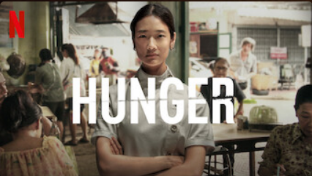






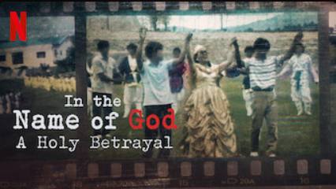

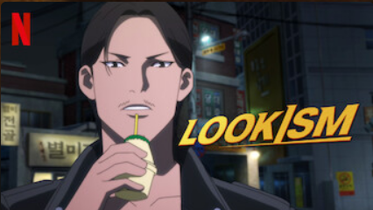

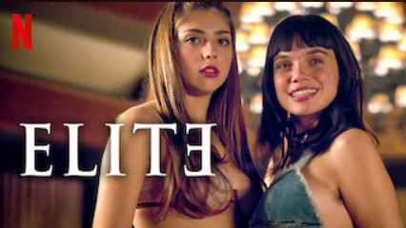
Home
Tv Shows
Movies
Latest
My List
Browse by Languages
Continue Watching

Slide 3
THE ART OF PROMPTING
CHATGPT
Prompt like a Pro: Supercharge Your ChatGPT ‘s Conversations

Slide 4


CLASS OBJECTIVES
CLASS AGENDA
Know the objectives of this class
Know what we will learn today

Slide 5
CLASS OBJECTIVES
Understand Chat GPT's Capabilities
Master Effective Prompting
Apply Prompting Techniques
Explore the underlying technology and training process of Chat GPT.
Understand the importance of context and iterative in optimizing prompts
Discover practical techniques to enhance conversations with Chat GPT using effective prompts

Slide 6
CLASS AGENDA
What is “Chat GPT” ?
Technicality to prompt
01
02
Prompt Like a Pro !
Prompting in Midjourney
03
04
Exploring a new and powerful AI model
Crafting effective cues for desired responses.
Elevate Your Prompting Skills to the new level!
Correct ways to prompt in midjourney

Slide 7
01
What is ChatGPT ?
We explore the technology behind Chat GPT, its training process, and the incredible possibilities it brings to conversational AI.

Slide 8
INTRODUCTION
GPT stands for Generative Pre-Trained Transformers
Launched by Open AI in 2018 and release on November 2022
Datasets limit until September of 2021

Slide 9
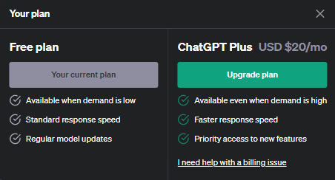

PACKAGE PLAN
FREE :
- Normal 3.5 GPT Version
PLUS :
Legacy 3.5 GPT Version (10 x faster normal GPT)
4.0 Version (limited to 25 prompts/ 3 hour)

Slide 10
02
TECHNACILITY TO PROMPT
Gain a deep understanding of chatGPT's functioning and mechanism

Slide 11
1. Know Your Objective
2. Context Matters
The importance of having a clear objective when prompting ChatGPT
Highlight the significance context when prompting ChatGPT

Slide 12
Know Your Objective
GOAL
SPECIFIC
TRANSPARENCY
Define your goal . Different objective have different prompt
Specificity is Key. Provide more detail
Avoid ambiguity. Be clear and concise

Slide 13
Context Of Matters
Provide relevant information Give necessary context to chatGPT
2. Tailor the prompt
Considered type of response looking for

Slide 14
03
PROMPT LIKE A PRO !
Practical Tips for Engaging Conversations with AI

Slide 15
GENERAL PROMPT
“I want you to act as __________ . I will be asking you about ________.
Tell me about_________ . Provide me in ______ form. “

Slide 16
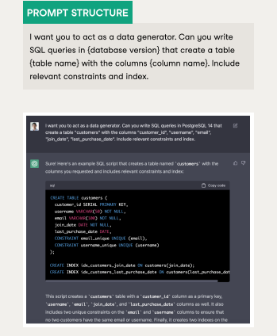

Slide 17
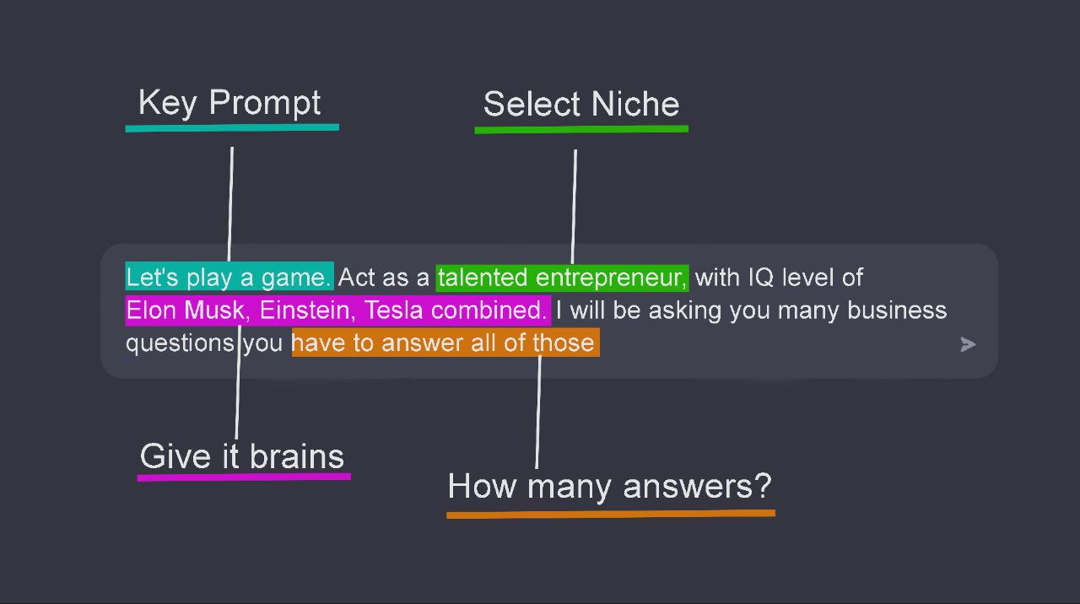

Slide 18
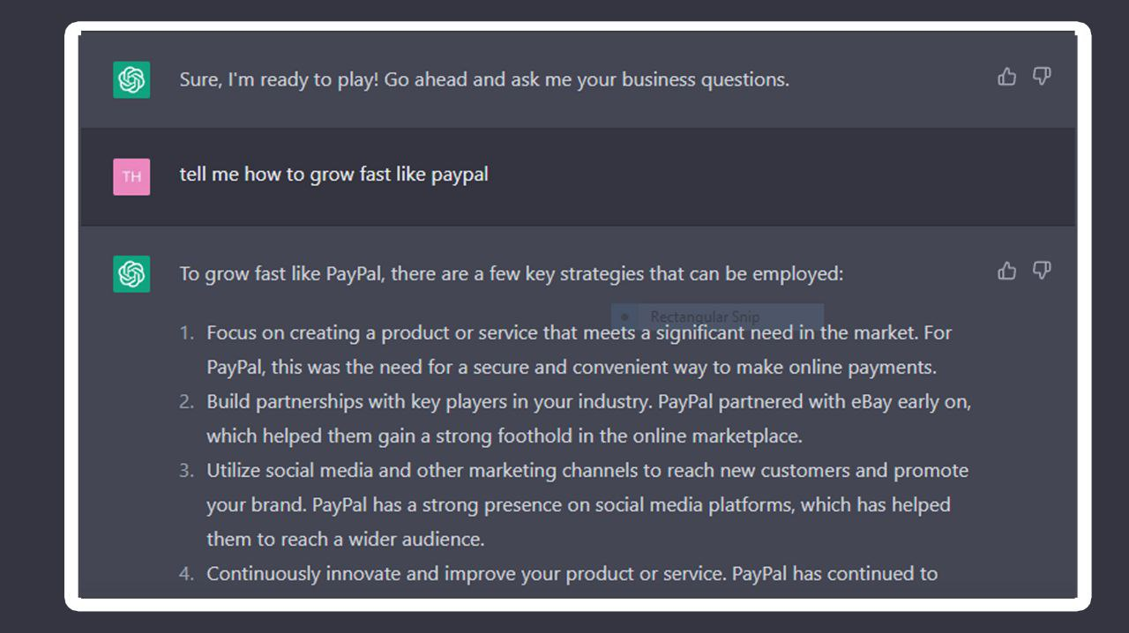

Slide 19
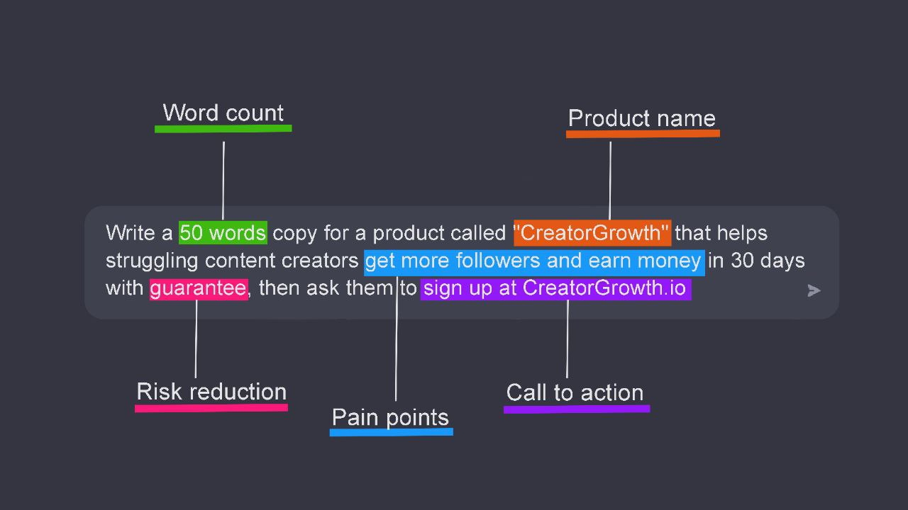
COPYWRITING

Slide 20
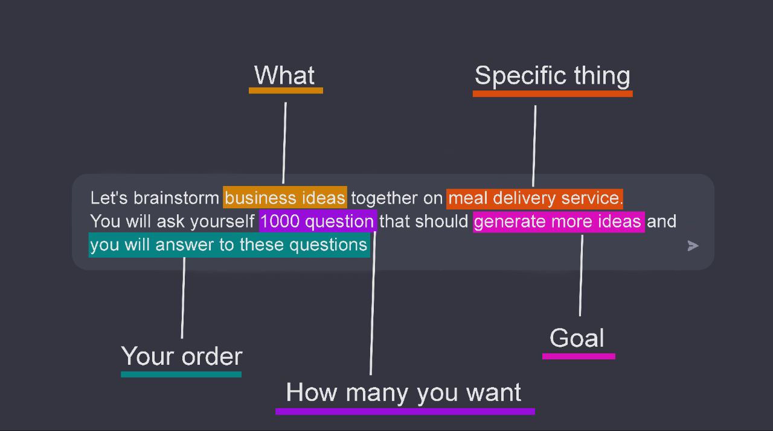
BRAINSTORM

Slide 21
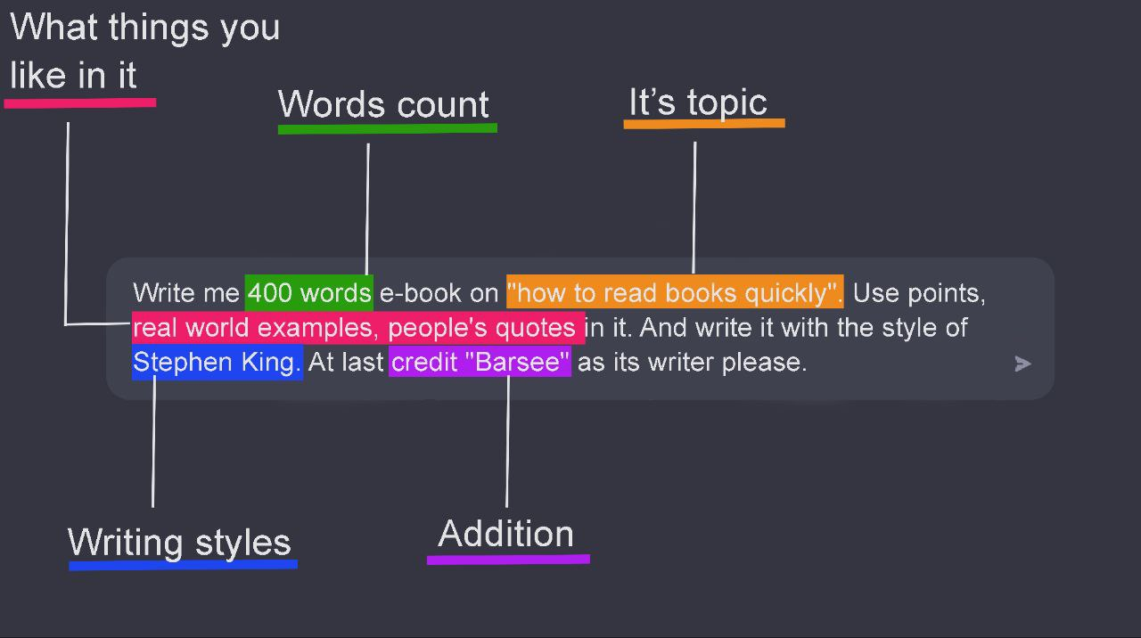
WRITING

Slide 22
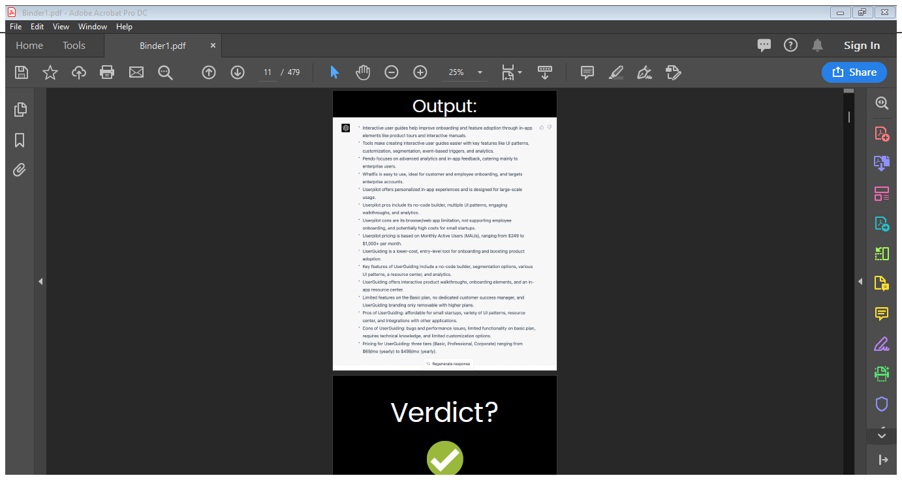
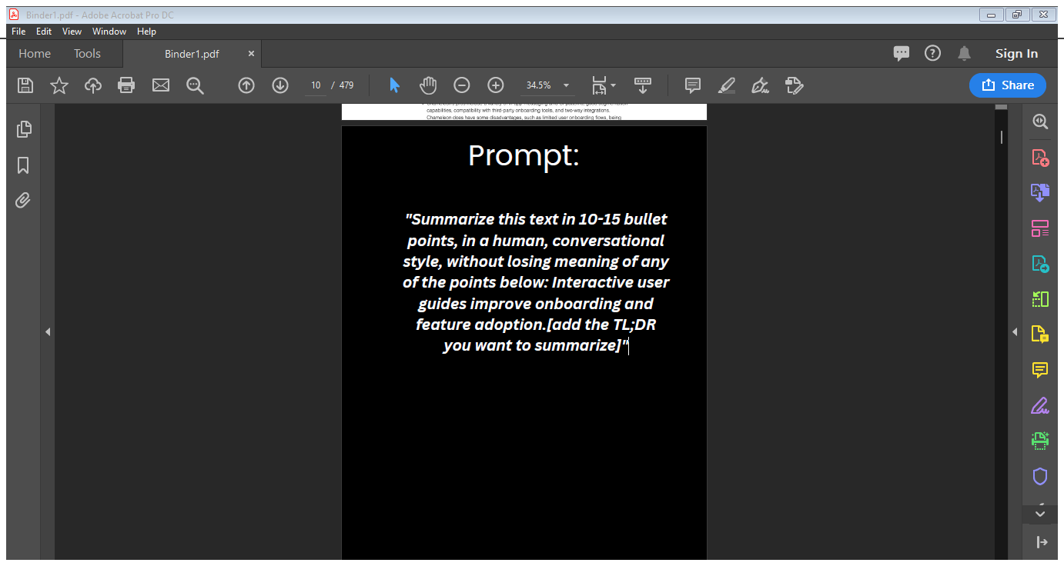
SUMMARIZING

Slide 23
04
PROMPTING IN MIDJOURNEY
Learn on how to prompt in a right way in midjourney

Slide 24
GENERAL PROMPT
Imagine prompt :
1. Type of photo
2. Subject
3. Subject Description
4. Parameter

Slide 25
TYPE OF PHOTO
01
02
03
04
STUDIO SHOT
CINEMATIC SHOT
MOVIE SHOT
DRONE SHOT
05
06
07
08
MAGAZINE SHOT
OUTDOOR SHOT
1960 SHOT
CLOSE UP SHOT

Slide 26
PARAMETER
VERSION & QUALITY
ASPECT RATIO
NIJI (ANIME)
STYLE
--V5 , --Q5
ar 3:2 / ar:16:9
-niji 5
-s (1-1000) / -s raw

Slide 27
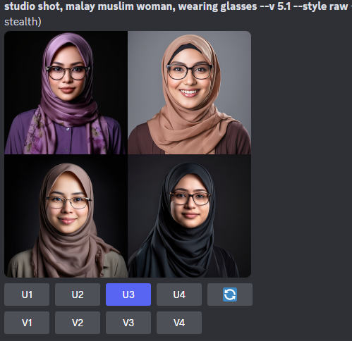
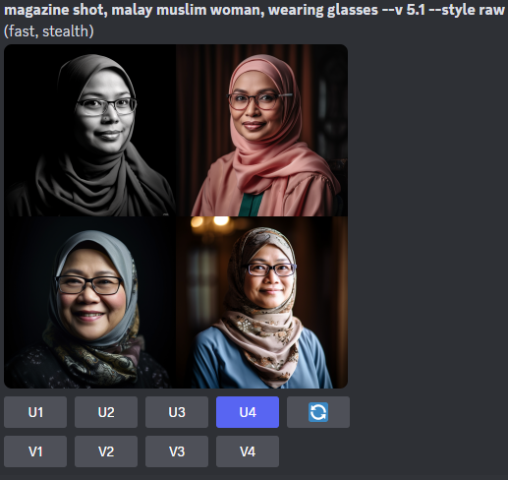

Slide 28
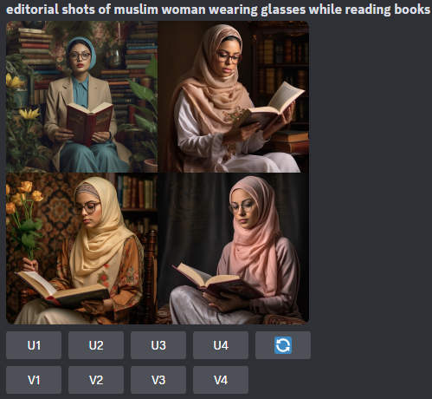
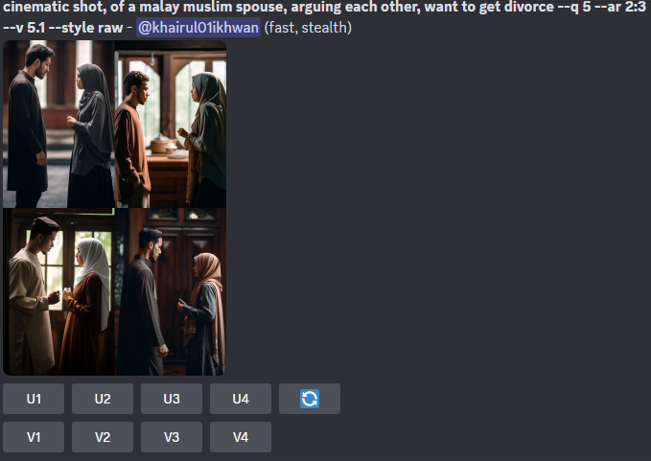

Slide 29
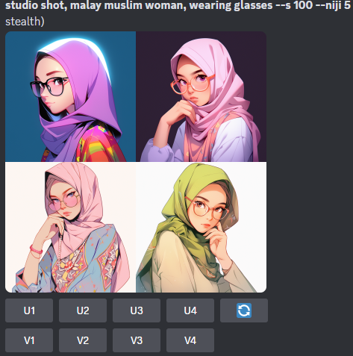
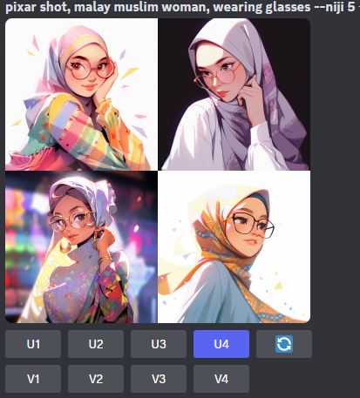

Slide 30
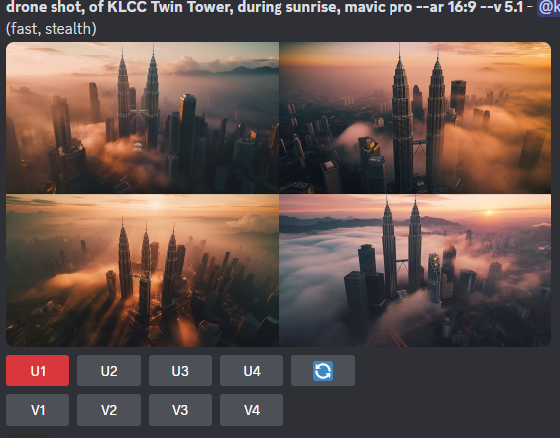
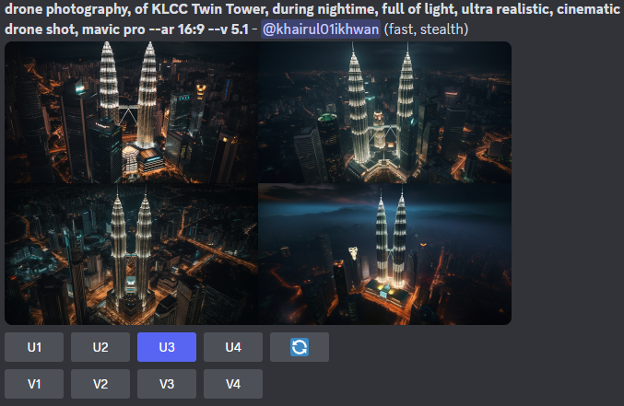

Slide 31
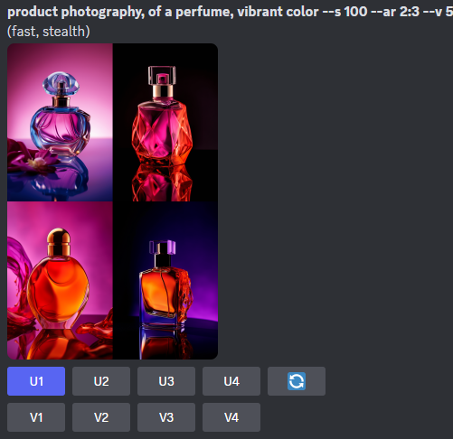
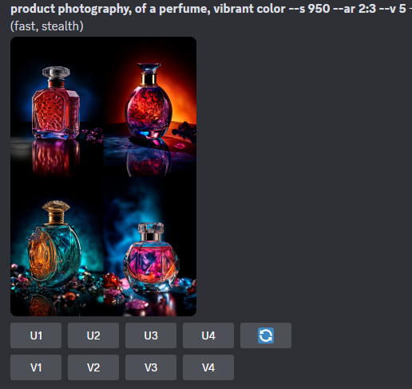

Slide 32
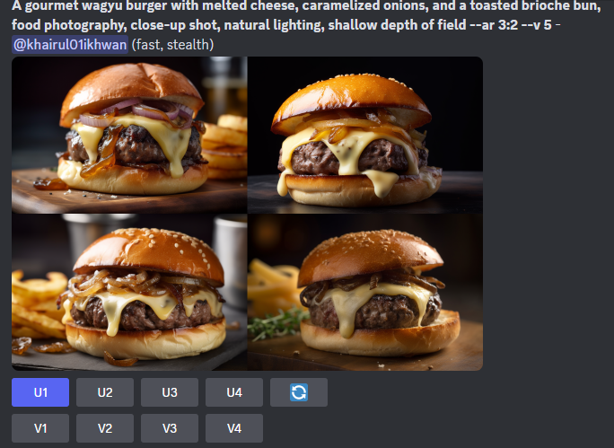
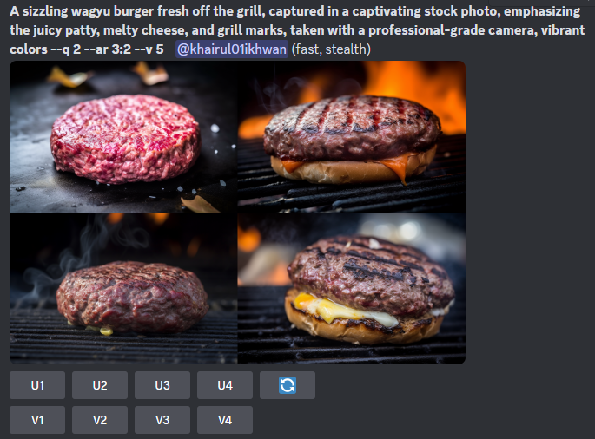

Slide 33
THE END
I would like to extend my heartfelt gratitude to all the attentive individuals in the audience who took the time to listen to my talk. Your presence and attentive ears are sincerely appreciated.

Slide 34
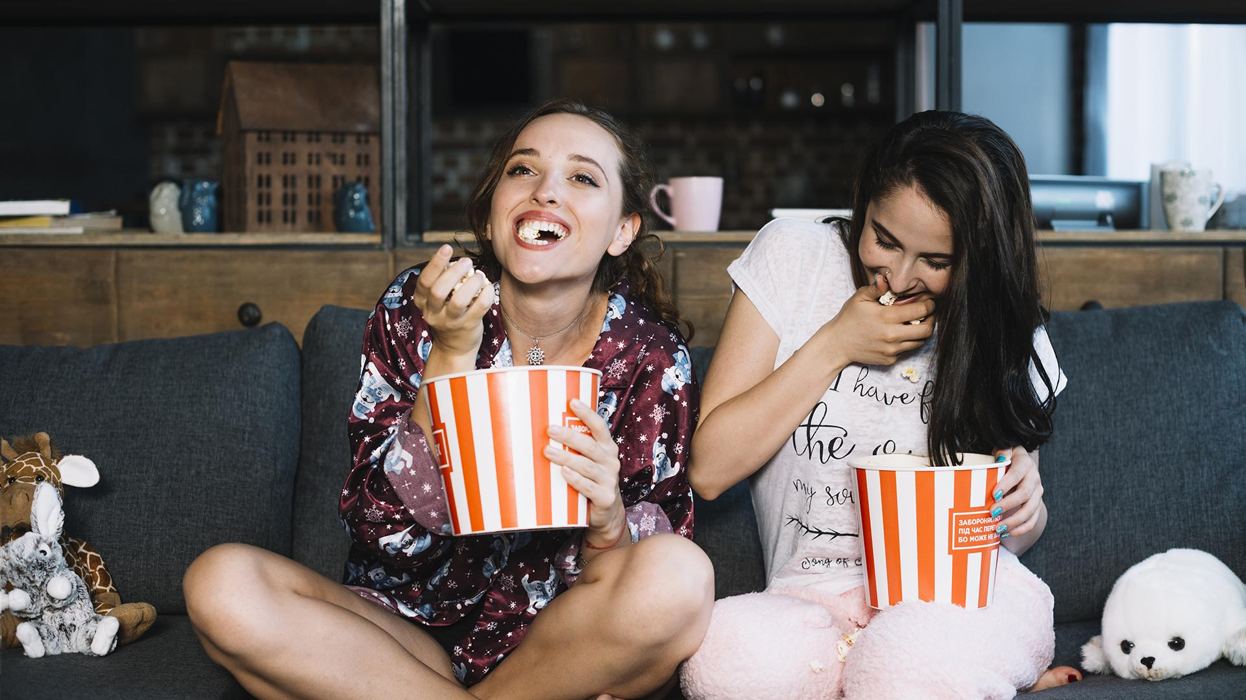
"A.I.: Empowering Business Beyond Imagination."

